Slide 1
iScheduling
Hans Ivar Skjelbred
User Meeting – 17.11.2021

Slide 2
See if SHOP can outperform current user settings with optimized commands
Is there any potential improvement?
  How to measure improvement
Can machine learning find the optimal commands?
  NTNU
Further research possibilities => learning from the future rather than the past

Slide 3
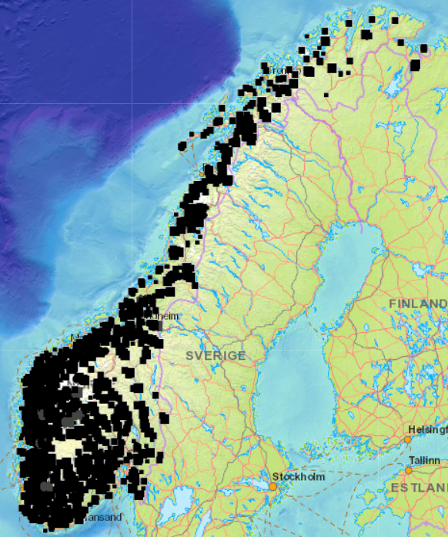
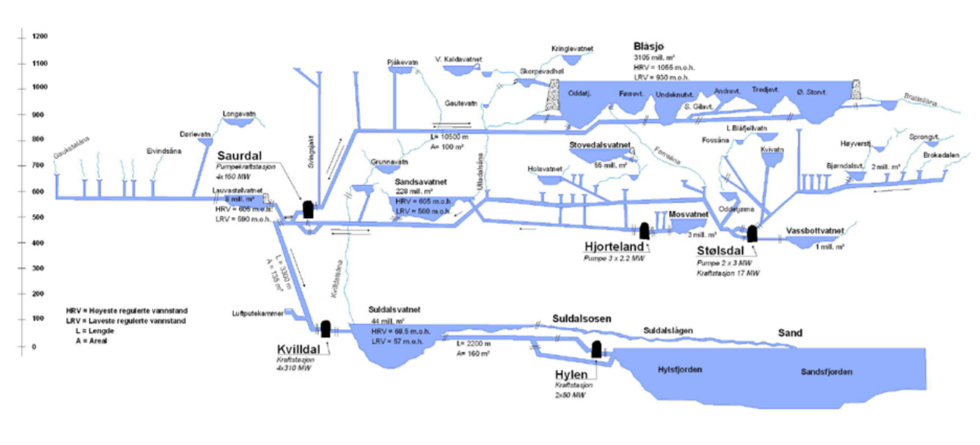
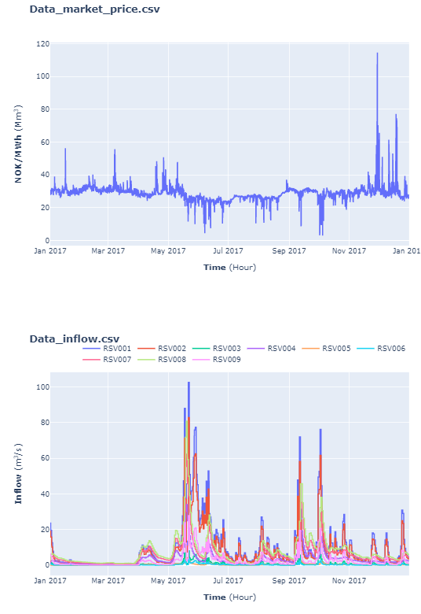
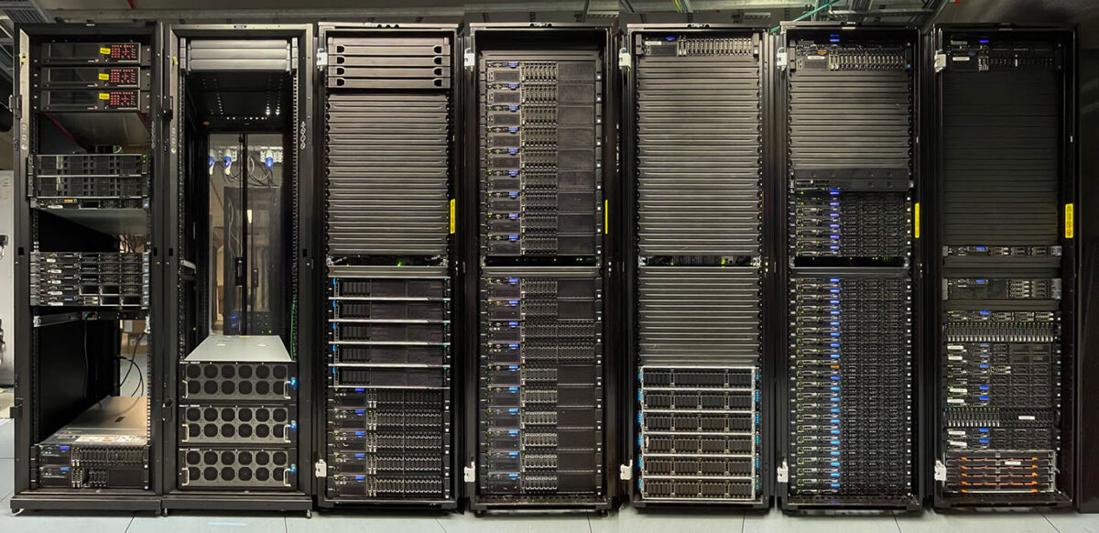
iScheduling – training
Hydro scheduling tools
Best setting
Set-up 5
Set-up 4
Set-up 3
Set-up 2
Set-up 1

Slide 4
iScheduling – usage
Condition recognizer
Best settings
Hydro scheduling tools

Slide 5
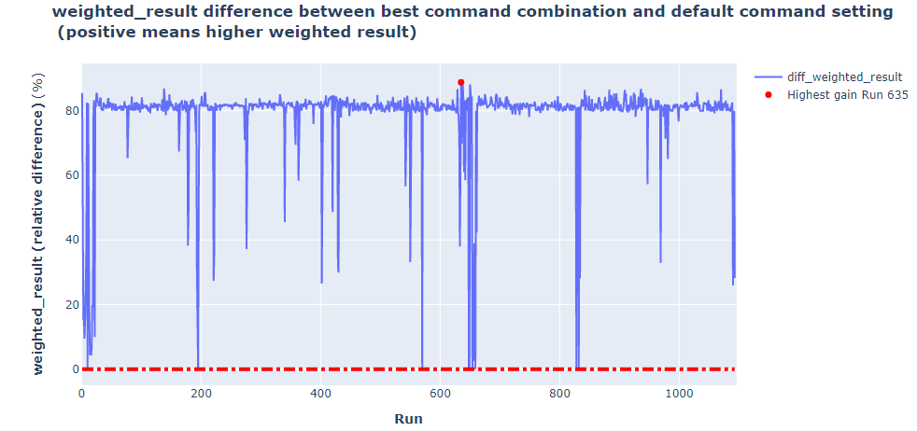
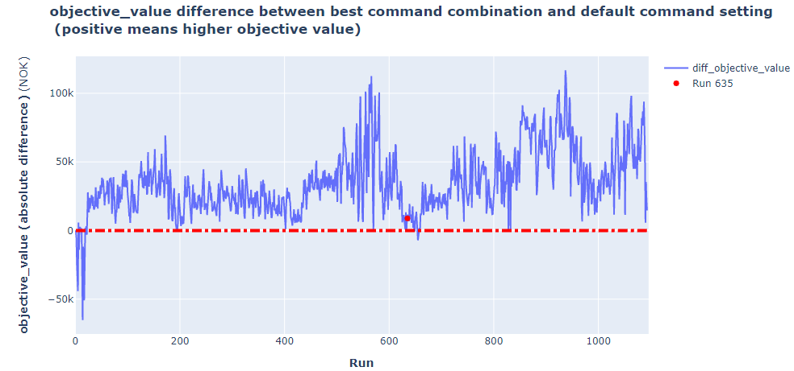
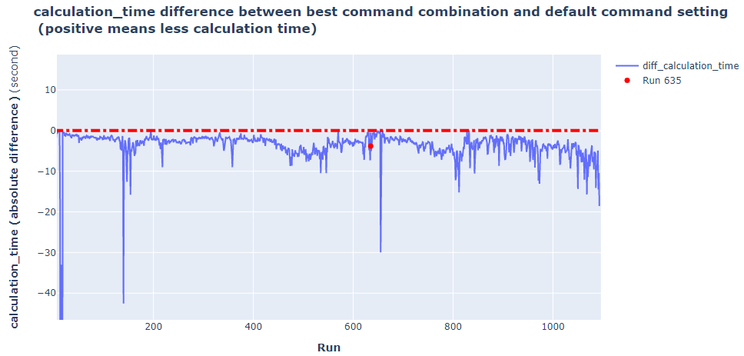
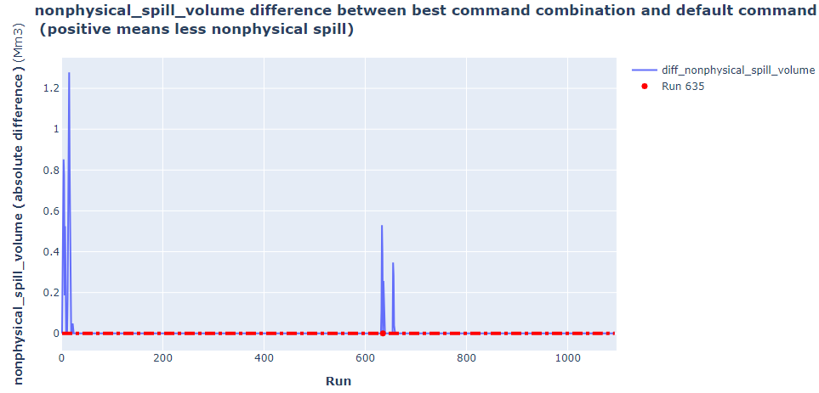
Visualize the result difference
  objective_value_weight = 0.4
  calculation_time_weight = 0.1
  nonphysical_spill_volume_weight = 0.5

Slide 6
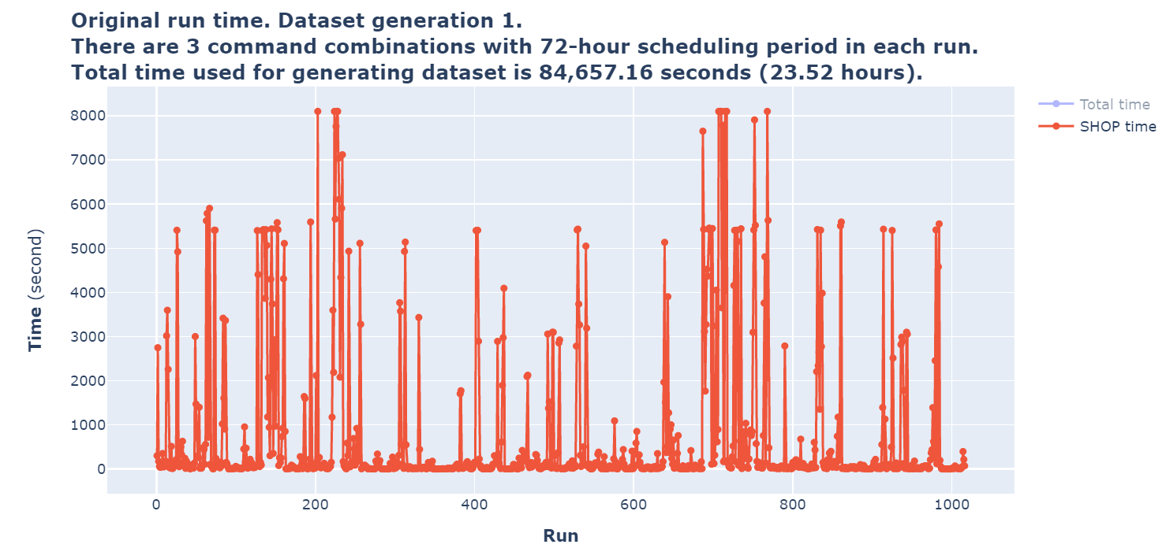
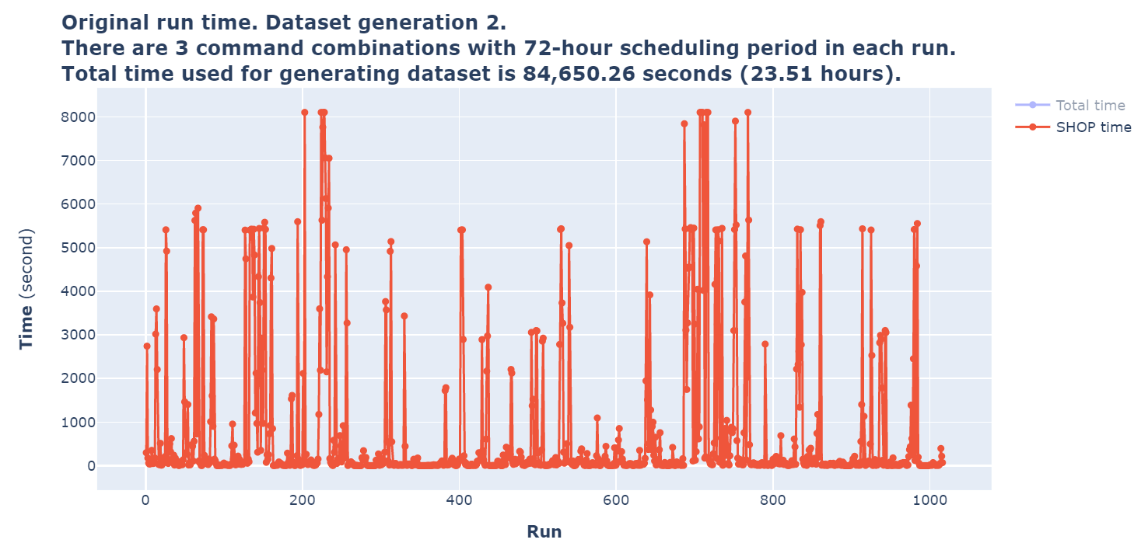
Improvement of dataset generation
Testing command 1 (mipgap): sole_result = 1007 (99.11%); multi_result = 9 (0.89%)

Slide 7
Can machine learning find the optimal commands?
 | 24 hour | 72 hour | 168 hour
Data info | C1 - 92% / 8% C2 - 78% / 22% | C1 - 73% / 27% C2 - 60% / 40% | C1 - 58% / 42% C2 - 47% / 53%
Accuracy | C1 - 91.5% C2 - 84% | C1 - 72.4% C2 - 71.5% | C1 - 60% C2 - 60%
Confusion matrix C1 | Correctly 0: 668 Correctly 1: 3 Incorrectly 0: 56 Incorrectly 1: 4 | Correctly 0: 493 Correctly 1: 41 Incorrectly 0: 153 Incorrectly 1: 43 | Correctly 0: 320 Correctly 1: 135 Incorrectly 0: 169 Incorrectly 1: 105
Confusion matrix C2 | Correctly 0: 546 Correctly 1: 70 Incorrectly 0: 90 Incorrectly 1: 25 | Correctly 0: 381 Correctly 1: 146 Incorrectly 0: 140 Incorrectly 1: 63 | Correctly 0: 222 Correctly 1: 217 Incorrectly 0: 167 Incorrectly 1: 123

Slide 8
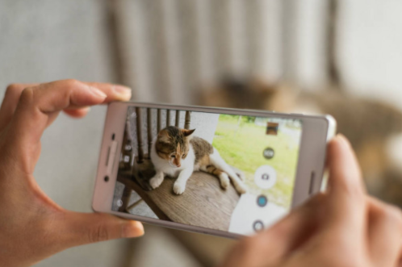
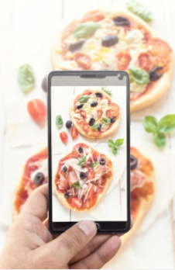
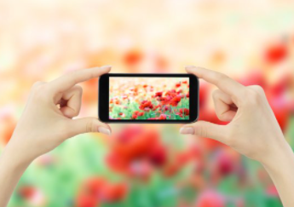
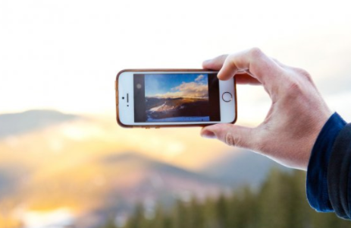
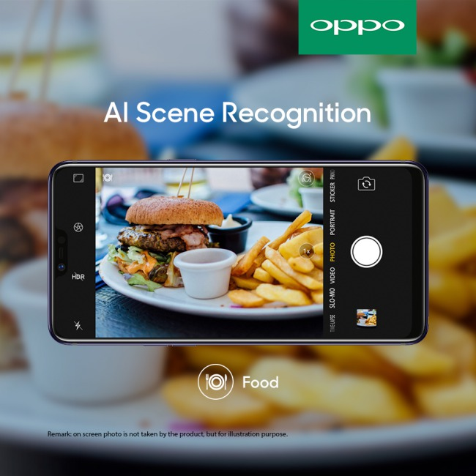
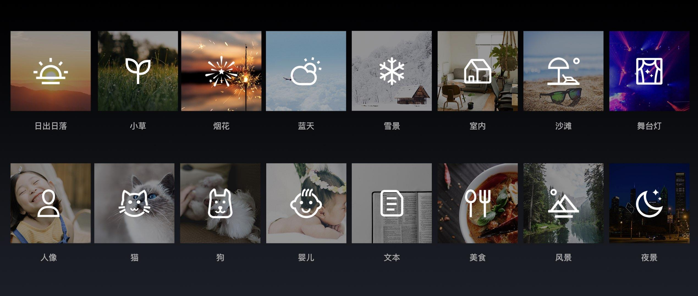
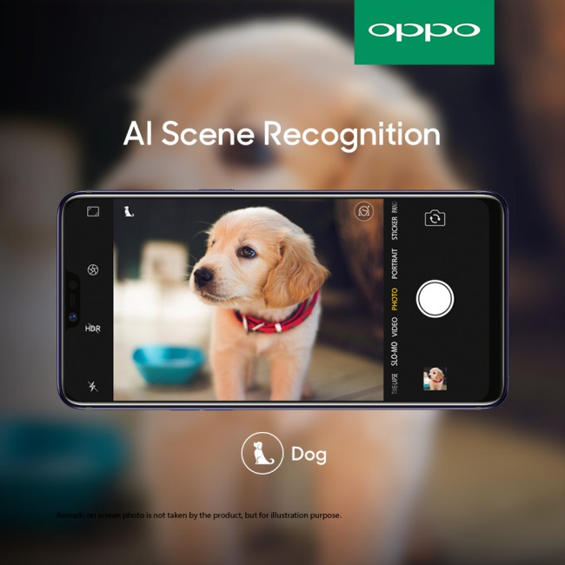
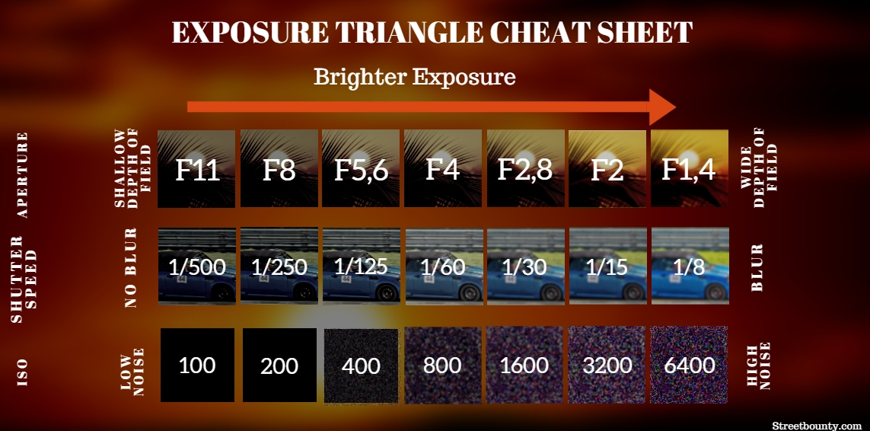
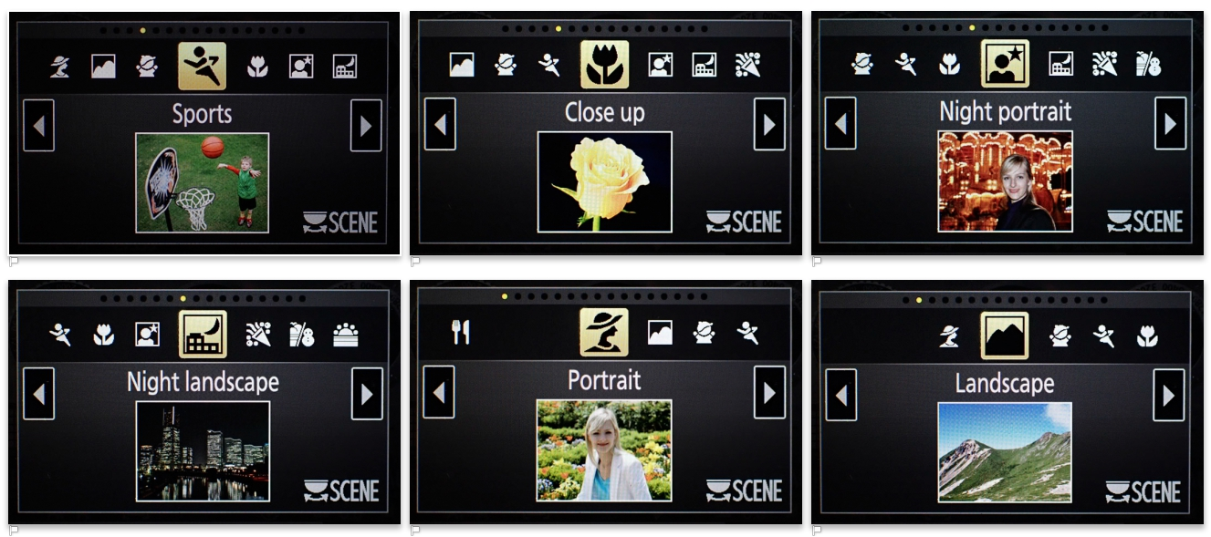
The Overall idea
AI Scene Recognition
Notes:
Ideen til prosjektet kommer fra hvordan vi tar bilder med mobilen. Alle vet at de bør velge riktig innstilling for å få et fint bilde, fordi det er forskjell på å ta bildet av landskapet eller katter, om dagen eller om natten. Men de fleste vil bare bruke standard innstilling og "klikke" for å ta et bilde, fordi de mangle erfaring med å justere innstilling for å få et perfekt bilde.
Nå løser smarttelefonen problemet. Den har en funksjon som kalles "AI Scene Recognition". Når du holder telefonen foran det du vil ta bilde av, vil smarttelefonen gjenkjenne hva det er. Telefonen justerer automatisk innstillingen og velger riktig scene før du klikker. Da har du en stor sjanse for å få et bedre bilde enn det som er tatt med standard innstiling.

Slide 9
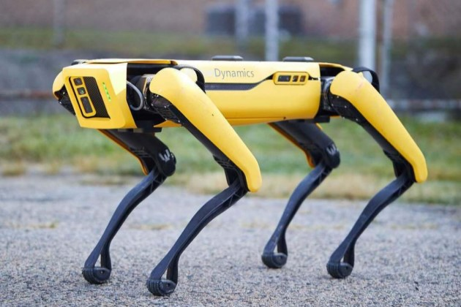
Possible topics for future research
iScheduling 1.0
Learn from the static past
iScheduling 2.0
Learn from the stochastic future

Slide 10
Possible issues for future research
In iScheduling 1.0, all the training dataset is generated based on the historical data, e.g., market price and inflow. However, the extreme weather caused by climate change happens more frequently. Stochastic data and other energy source (i.e., sol and wind) should be taken into consideration to generate a bigger dataset and represent a future-oriented picture.
In iScheduling 1.0, all the watercourses tested are simple with limited number of plants and reservoirs. It is important to develop more heuristics to reduce the number of input data columns. Then big cascaded watercourses can be tested.
In iScheduling 1.0, all the commands checked are one-time setting. It is possible to extend to be a time-dependent and object-dependent setting.

