Slide 1

Calibration options in EMPS?
Geir Warland
User meeting Hydro Scheduling 2021

Slide 2
Agenda
Why calibrate
How calibrate
  Standard calibration
  Additional functionality
Some issues
Examples

Slide 3
Why calibrate
SDP – Stochastic Dynamic Programming
  Curse of dimensionality
  Aggregation of hydro
Handling of multi-area hydro
  Strategi (water values) per area
  Spatial inflow correlation
No formal optimization in EMPS
  Auto-calibration possible, but difficult to find global optimum
  Time-consuming and difficult to «beat system expert»
Other market participants
  «non-fundamental» behavior?
    Marked adjustment of price forecasts?
    Simpler strategy based on calendar & historical values?
  Different views on future development for input data

Slide 4
What is calibration
Calibration affects assumptions for the water value calculations
NOT the final simulation
  Demand adjusted by calibration factors only used for water value calculations
  Real values used in simulation
Trick to adjust or tune strategy
Not formal optimization but adjusted by user
  Socio economic optimum
Calibration strongly depending on simulation results

Slide 5
How calibrate
Calibration factors per area
  modifying firm and
  price dependent demand per area in strategy calculations
Minimum aggregate hydro production capacity in water value calculations
Time-dependent calibration factors
Auto-calibration
  Sosio-economic optimum
  Minimize deviation from control- or reference curves
“Autvekt“ – manual vs automatic weighting of inflow
Other:
  only exclude non-avoidable spillage from regulated energy inflow series (MAD)
  «hard-kjør» - method

Slide 6
Calibration factors
Feedback factor
  F_{k} = α_{k} * W_{k}
  Higher F_{k} (α_{k})
    => higher probability of rationing
    => more restrictive use of water
    => increases reservoir-curves
Form factor
  Adjusting the yearly profile in firm demand in water value calculations
  Higher form factor increases difference between winter and summer reservoir curves
Elasticity factor
  Factor scaling the level of price dependent demand
  Lower elasticity gives lower spread in simulated reservoir
VVMINP – minimum production capacity in aggregate model
  A high value of VVMINP increases water values in lower part of aggregate reservoir
F_{k} = Firm demand in wv-calculation
α_{k} = Feedback factor
W_{k} = P_{hydro,mean} in area
k = timestep

Slide 7
Automatic vs manual weighting of inflow –water value calculations
Probability distribution for sum inflow over seasons to low because of independence
Automatic weighting
  Gives increased weight on extreme inflows
Consequence for water value calculation
  See increased probability for curtailment and overflow
  Less risky operation

Slide 8
Calibration: strengths and weaknesses
Strengths
Very flexible calibration options “Anything” is possible
Possible to adjust to “non-fundamental” price developments
Automatic calibration possible
  Socio economic surplus
Weaknesses
No search for global optimum
No formal optimization of strategy with respect to reservoirs in other areas
  Solves area strategies “independent”
Automatic calibration (calibration in general) very time consuming
User dependent
User dependent

Slide 9
High inflow scenarios?
EMPS a little slow to recognize high inflow scenarios?
Example spring 2020
  Forecast «is lagging» in development relative to realized inflow
Explanations?
  Weakness in area modelling? Energy inflow?
Solutions?
  Energy inflow correction (MAD-functionality)
  Time dependent calibration facts (criterion for selecting factors?)

Slide 10
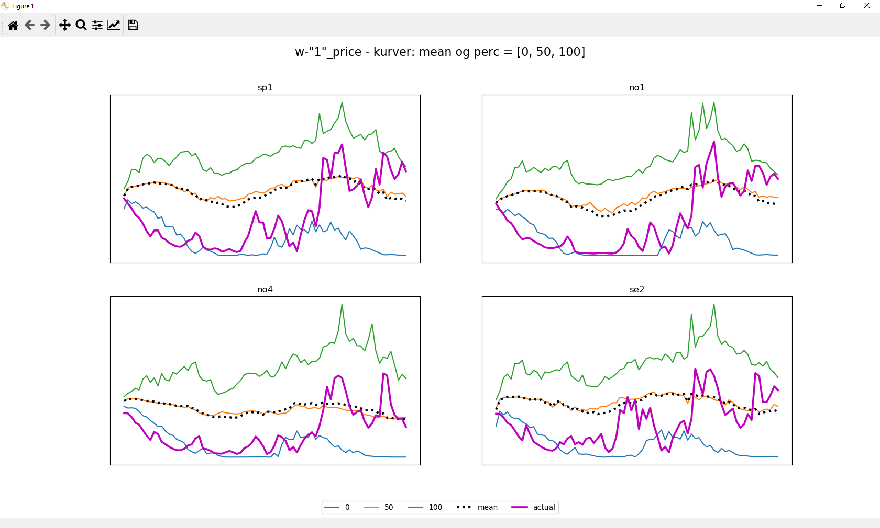
Prices and EMPS-forecasts in spring of 2020

Slide 11
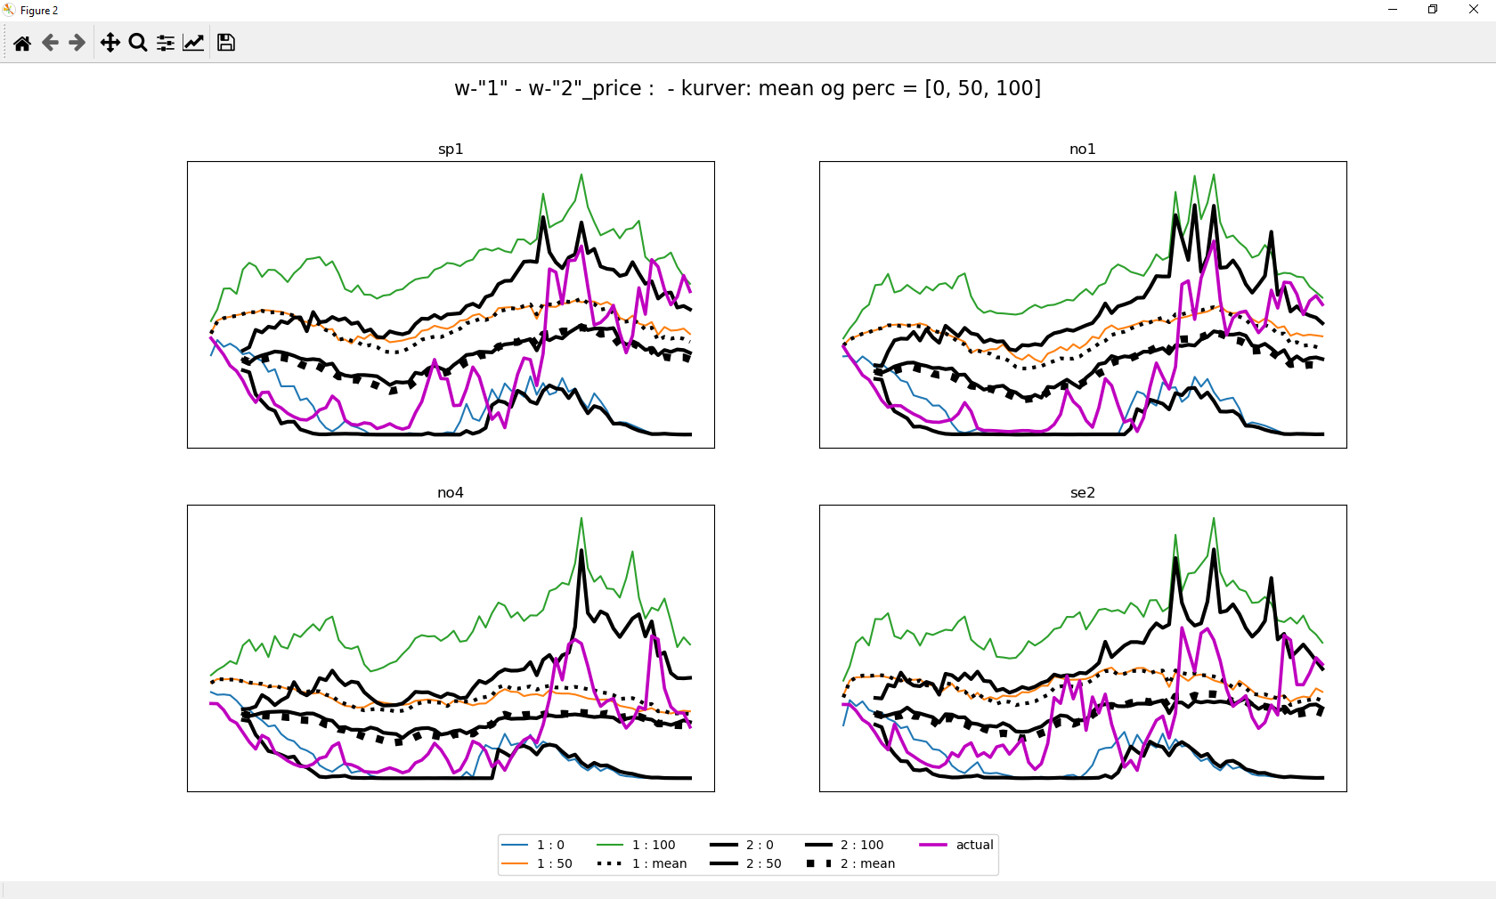
Prices and EMPS-forecasts in spring of 2020

Slide 12
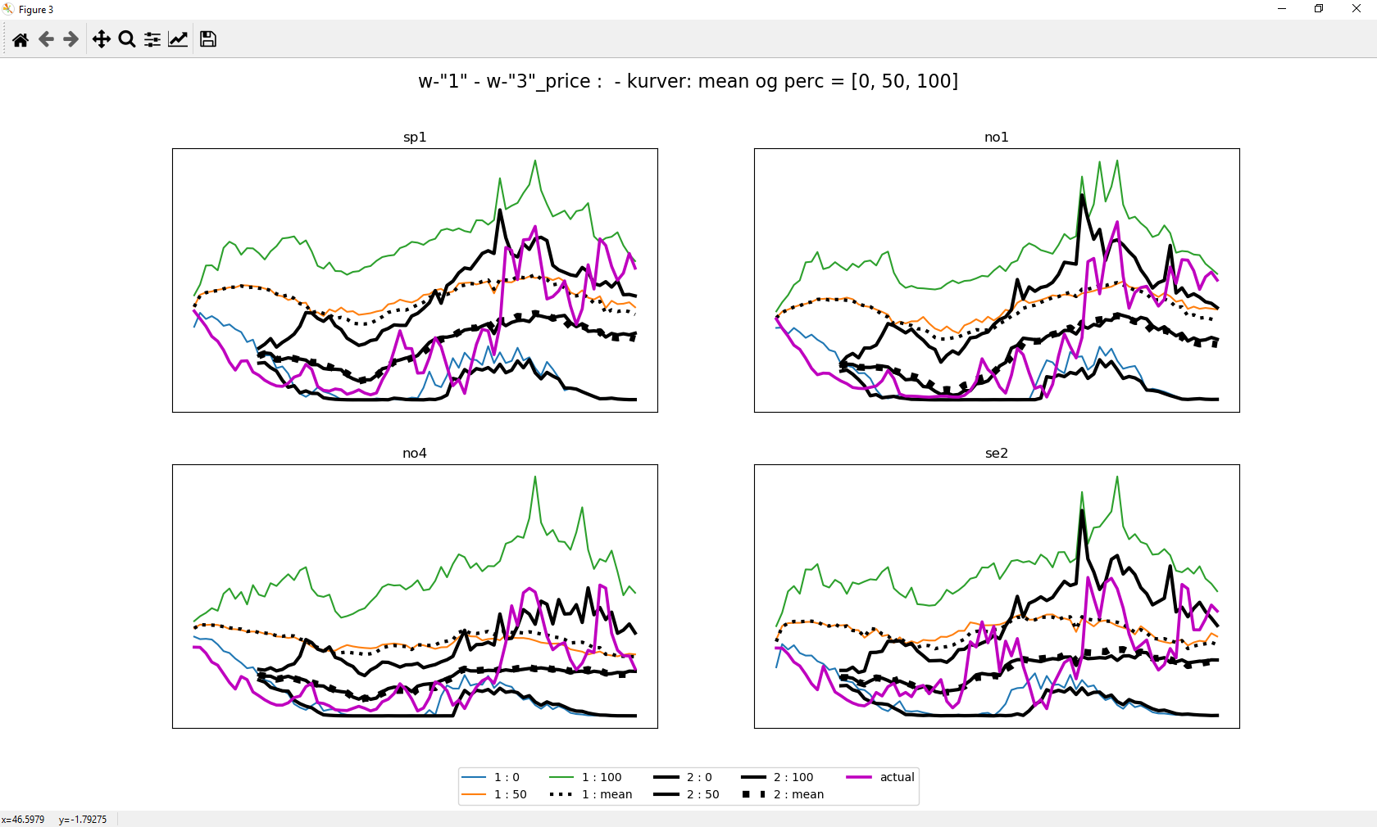
Prices and EMPS-forecasts in spring of 2020

Slide 13
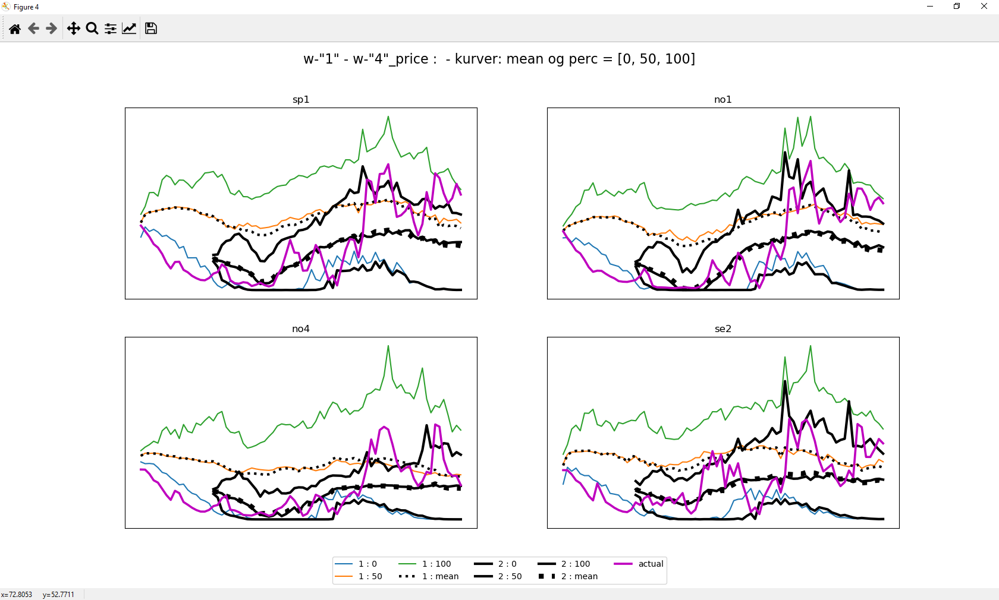
Prices and EMPS-forecasts in spring of 2020

Slide 14
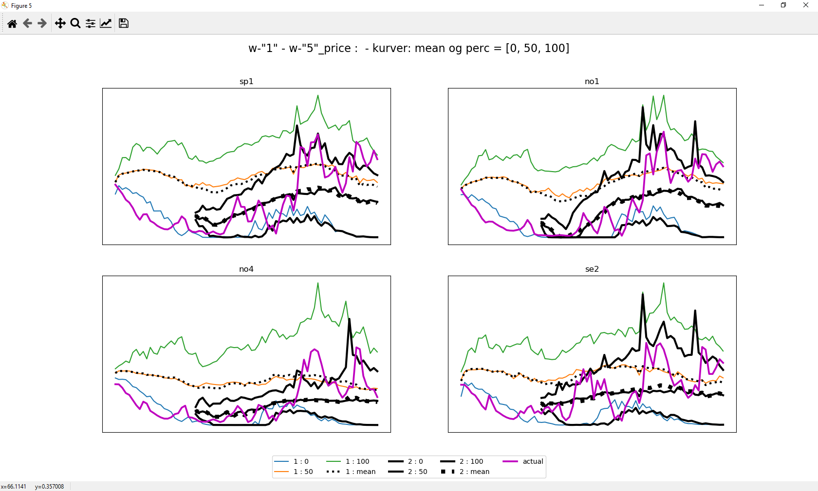
Prices and EMPS-forecasts in spring of 2020

Slide 15
Time dependent calibration possible?
«Hardkjør-metoden»
  By «manually» splitting calculations
  Water value-calculation for separate periods
    Regular calibration for last year
    Manually override calculations for first period
Time dependent calibration factors in EMPS
  Feedback-, form and elasticity factors can be given individually per week
  However, the strategi calculations not limited to given period:
    Fk = αk * Wk
    The simulated hydro production is affected for the whole period, not only in limited period
    Affecting the demand in next iteration

Slide 16
Time dependent calibration factor - example
Reduce feedback factor in a 15 weeks period
Ideally lowering reservoirs (water values and prices) in selected period only
But not limited
  Explanation: (Fk = αk * Wk )
  Reservoir filling and hydropower production affected also in period beyond.
    In first iteration lower feedback factor => lower water values and higher production in period.
    Resulting in lower reservoir level, higher water values and lower production in next period
    In next iteration a lower hydro production in subsequent period(s) gives lower demand for water value calculations, giving lower water values and higher production
    …
  Resulting time dependent calibration affecting period beyond initial period

Slide 17
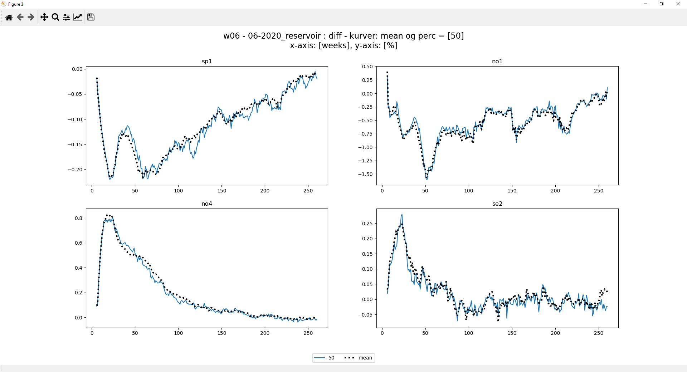
Time dependent factors: Reservoirs

Slide 18
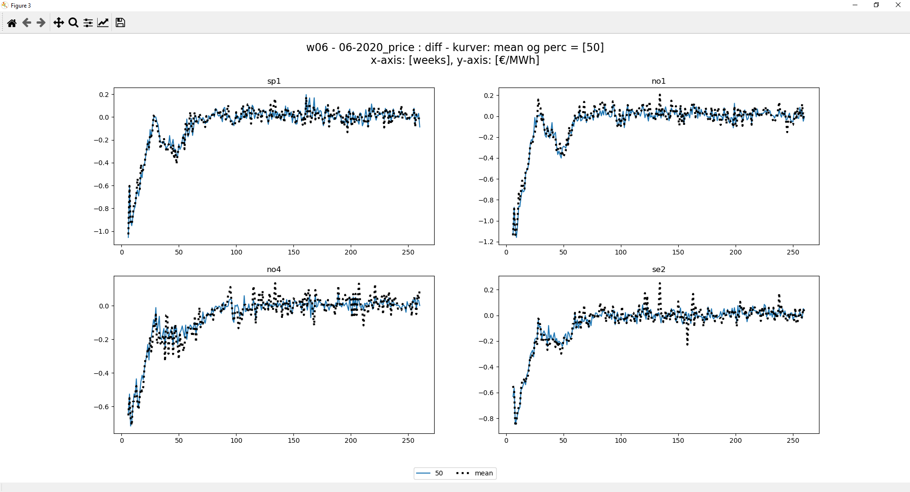
Time dependent factors: Prices

Slide 19
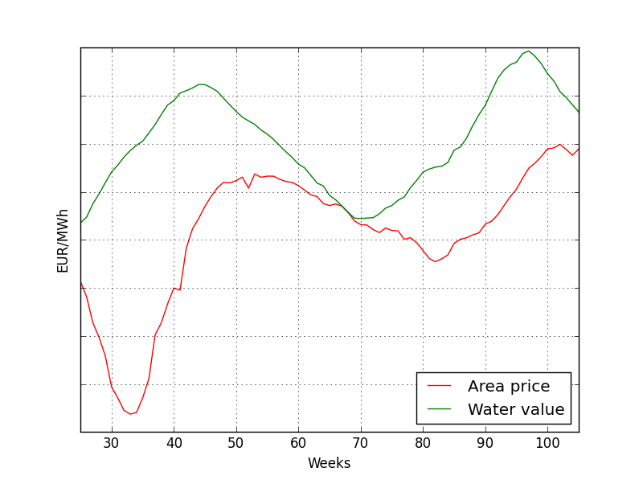
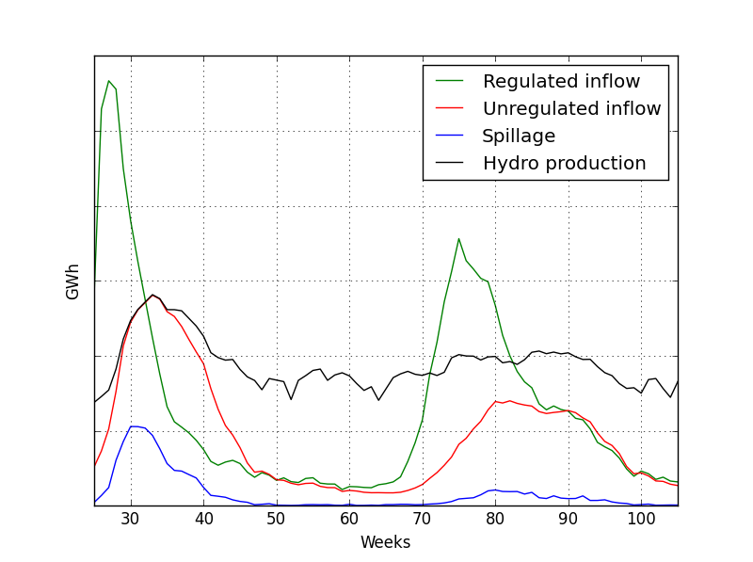
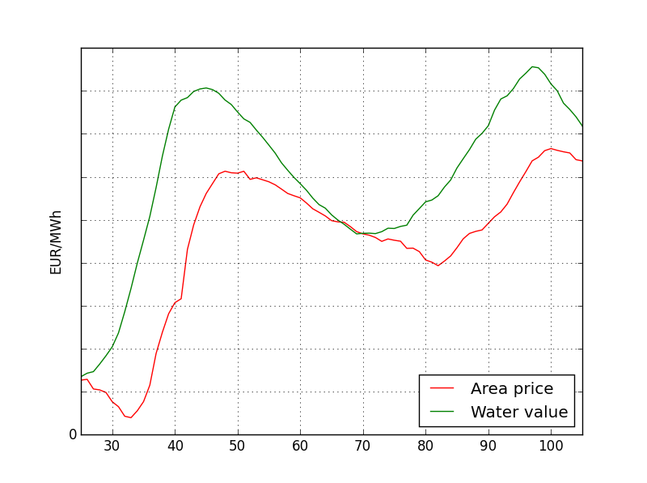
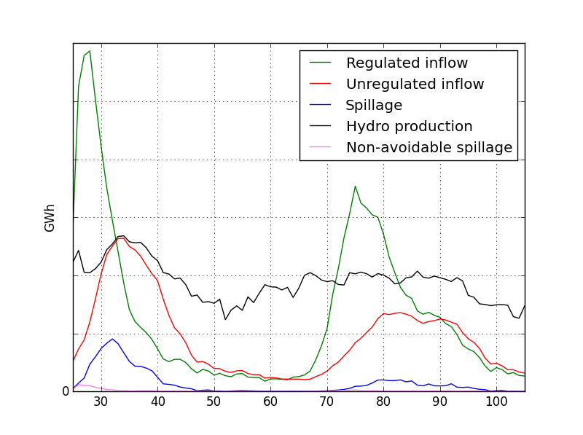
«MAD» - functionality
Standard energy inflow in EMPS
Only non-storable spillage subtracted from regulated energy inflow

Slide 20
Energy inflow to aggregate models in EMPS
Regulated inflow =
Sum of production
- unregulated inflow
- energy used for pumping
+ change in reservoir level
- spillage and bypass
Unregulated inflow =
Production due to unregulated inflow to hydropower plants
+ production due to minimum discharge requirements
+ production to avoid spillage
- energy used for pumping to avoid spillage
In «MAD» functionality only non-avoidable spillage is subtracted from the calculation of regulated inflow
Higher regulated inflow to aggregate model

Slide 21
Some issues
Non-fundamental behavior
Demand-increases in part of period can lead to unexpected lower prices in other periods
Increased initial reservoir can lead to increased initial water values
Issues related to feedback – mechanism (F_{k} = α_{k} * W_{k} )

Slide 22
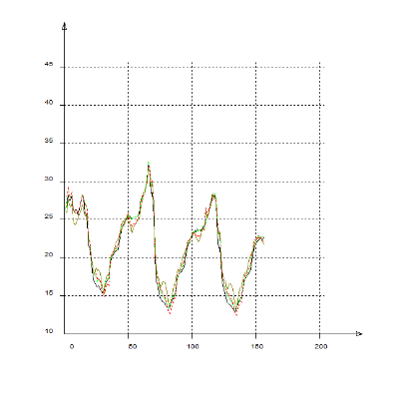
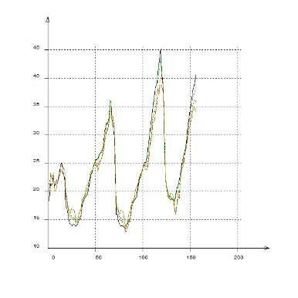
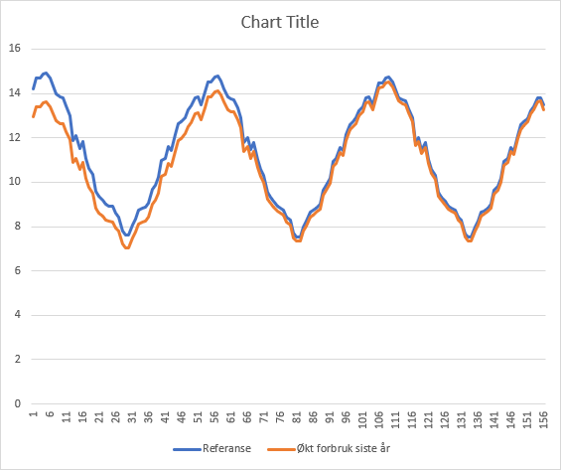
Non-fundamental changes: demand
«Non-fundamental» changes in front weeks when increasing demand in end year
P_{pre,mean}
P_{post,mean}
Increased demand last year
Increased simulated production 1. iteration
Increased consumption in water value calculation
Increased water values whole period but most near end of period
Decreased hydro production in 2. iteration due to higher WV’s
Lower demand in 3. iteration near front => lower demand
…
DEMAND_{watervalue}

Slide 23
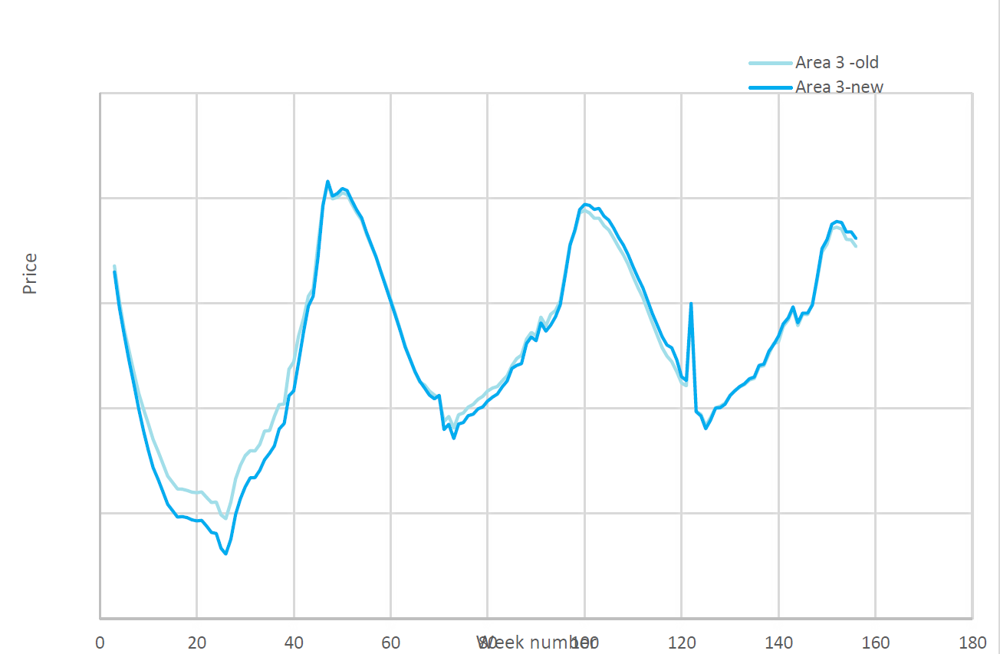
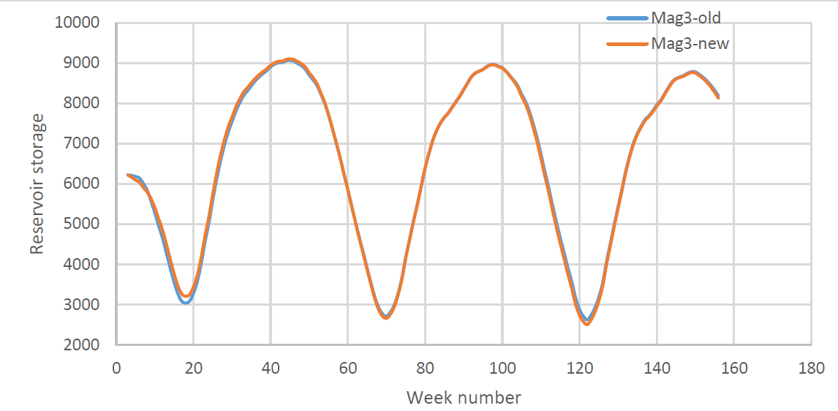
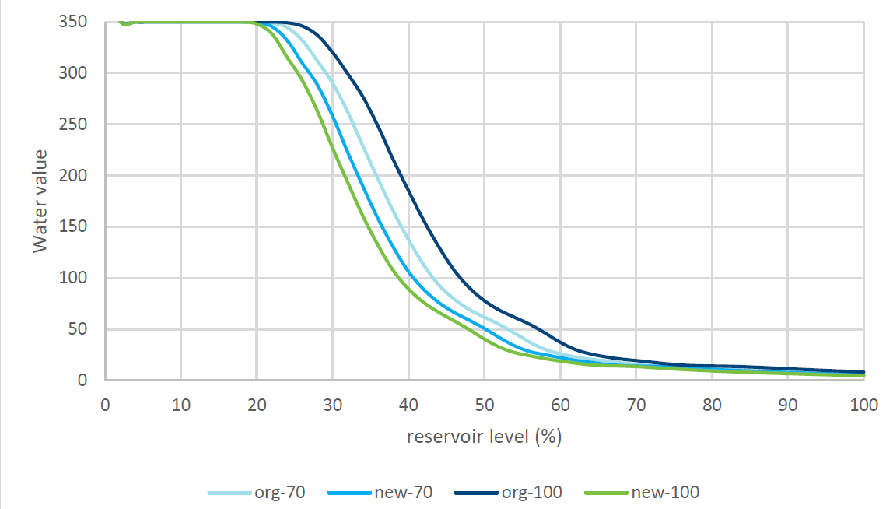
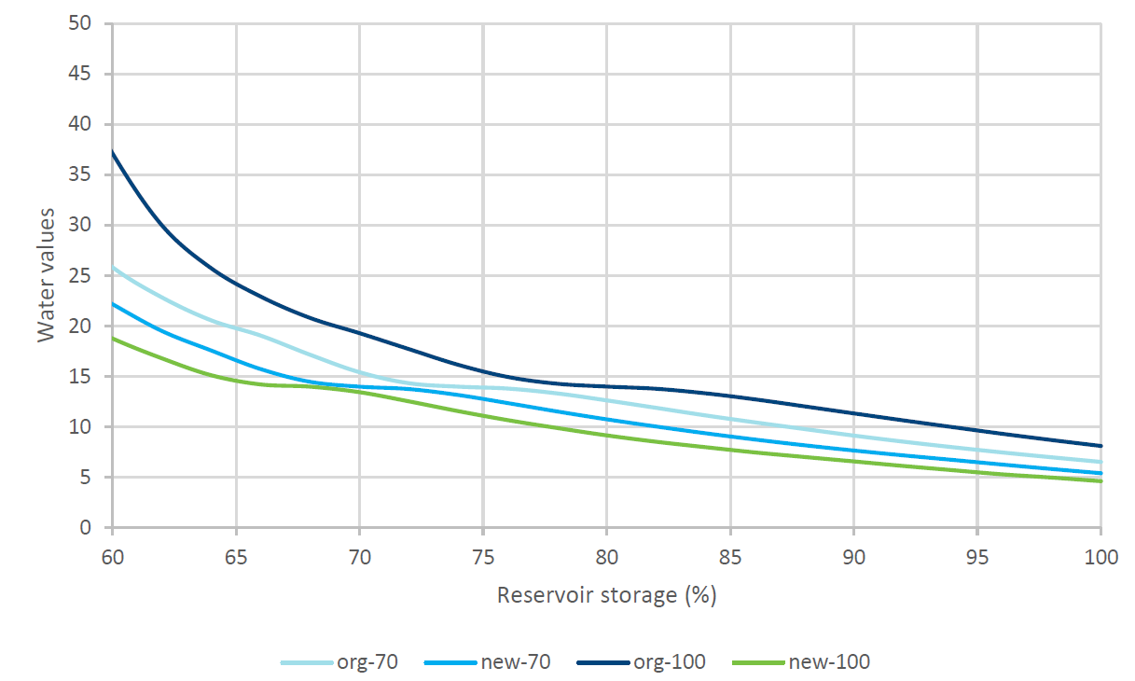
Non-fundamental changes: initial reservoir
Explanation
  initial storage level creases
  sum hydro production will increase
  increase load in the next iteration
  most visible for areas with high flexibility
The same illogical response can probably also be observed for changes in the inflow forecast.
Solution
  Market in water value calculation depending on hydro production last year
  More logical response to changes in initial conditions
Example:
  Curve 1 & 2: simulation with std and new functionality
  Curve 3 & 4: water values for 70 & 100 % filling with std and new functionality
Solves non-fundamental behavior,
but can lead to lower socioeconomic surplus

Slide 24
Summary
“All models are wrong, but some are useful”. George EP Box
EMPS is not perfect, has some issues, but is definitely useful
No global optimization => need for calibration
Many calibration options
  All tested properly (by users)?
  More needed?
Improved calibration possible?
  Formal search for optimum
  Input from models using formal optimization (SDDP, FANSI, …)

Slide 26
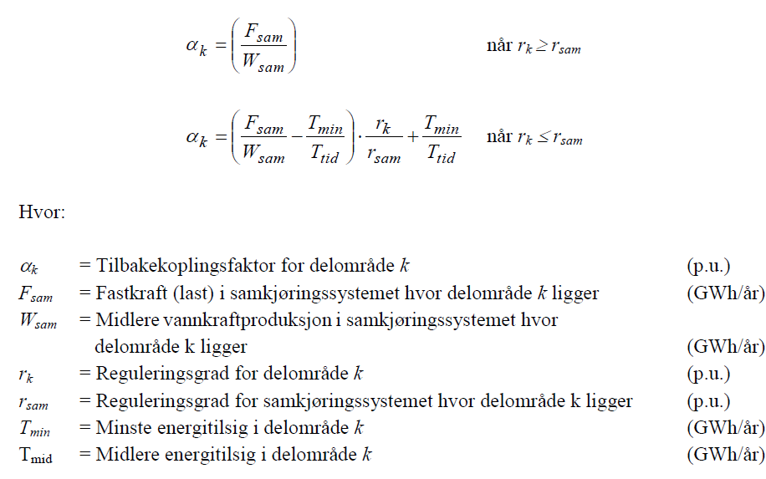
Kalibreringsfaktor: Default-verdi

Slide 27
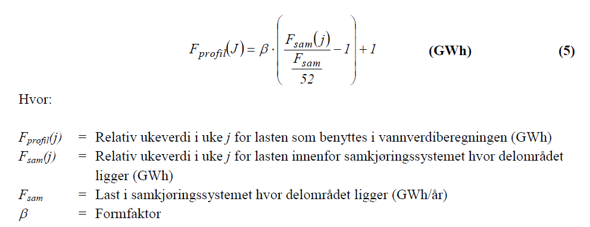
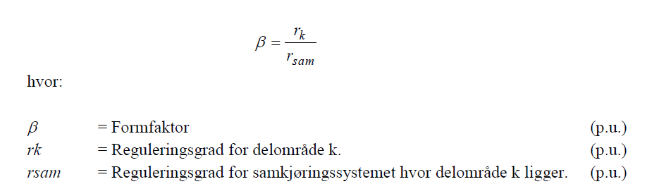
Formfaktor
Høyere formfaktor gi høyere vinterlast og heving av magasinkurver på vinter, tilsvarende senking på vår/sommer
Default

Slide 28
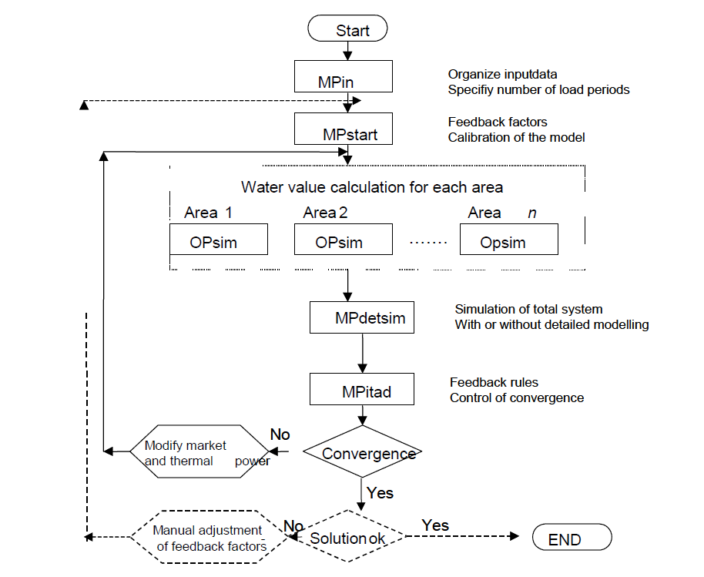
Strategy-calculations in EMPS

Slide 29
«Hardkjør-metoden»
Standard calibration in last year of simulation periode
STFIL, select set shorter period
- NO to WV-calculations
- set new calibration factors (for shorter period)
Manually run strategy-iterations (NB NOT standard STFIL)
  VANSIM (manually)
  SAMTAP (area or detailed simulation)
  KOPL

