Slide 1
User meeting 17/11-2021
EMPS Version 10, Agder Energi
Status, plans and experiences
Ståle Huse, Special advisor
ae.no @Agder_Energi @agderenergi

Slide 2
My background
Education:
1994 Master of Science, Electric Power Engineering, NTNU (NTH)
1998 Ph.D., Electric Power Engineering, NTNU
Work:
1995-2006 SINTEF Energy Research, Energy systems department
EMPS simulations
Development in the long term models (EOPS, EMPS, Prodrisk)
2006-> Agder Energi, Energy Management and Trading
Setting up external models
Development of in-house models

Slide 3
Version 10 at Agder Energi
Main goals when starting project
Upgrade to EMPS version 10
Simplify work process
Excel -> Python

Slide 4
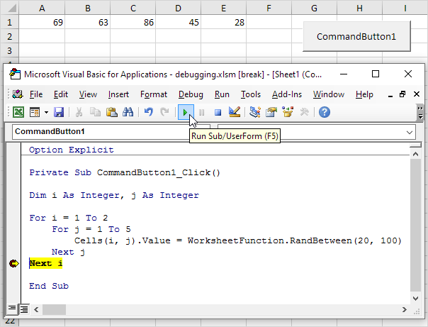
How we have been using EMPS
VBA generated scripts

Slide 5
Goal
Input to the model
Database 1 API
Database 2 API
LTM API
. .
.
Database/data source n API
Manual input

Slide 6
Goal
Output from the model
LTM API
Result storage

Slide 7
Reality
Output from the model
LTM API
Result storage
Ongoing work

Slide 8
Status EMPS 2021
Parallell runs v9 and v10 end april-start may
Only version 10 from mid may
Still using Excel and VBA to generate input scripts for EMPS
Inflow forecast written by Python and LTM API
Ongoing process Excel VBA -> Python

Slide 9
Experiences
No problems with version 10 so far (other than unfamiliar menus and run sequences)
Possibilities for hourly input makes things easier
Direct specification of input
No need for specifying input per load block or by profiles
Python gives much simpler code and easier to maintain compaired to VBA
Version control in Git
AE Python packages distributed by Azure Artifacts

Slide 10
Notes:
Birkelandsfossen, Evje og Hornnes

