Slide 1
Digital lab modelling
Bjørnar Fjelldal, SINTEF Energy Research
Notes:
Hi! My name is Bjørnar Fjelldal, and I am a research scientist at SINTEF Energy research, where I, when it comes to our models, work mainly on SHOP and everything related to it.

Slide 2
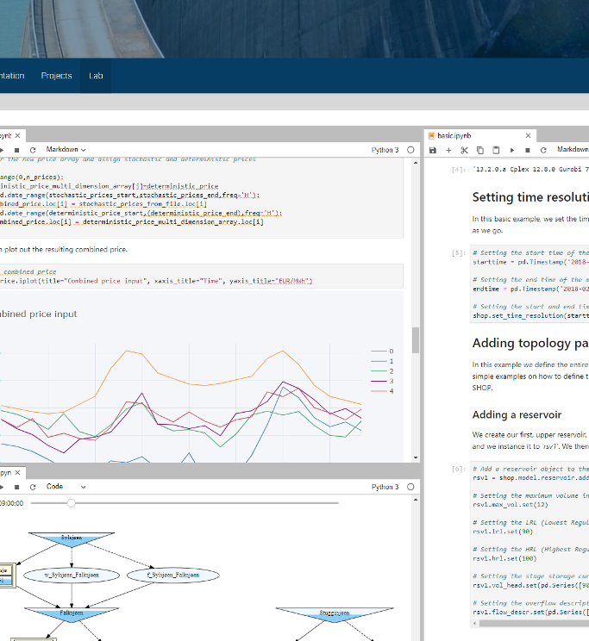
Background
Proper communication and collaboration is key to success
Enabled by state-of-the-art (open-source if possible) tools and technologies
SHOP Portal
SHOP Lab
Notes:
Here at the SHOP team we aim towards constantly develop and improve our way of communicating and collaborating with our users of SHOP, because these elements are vital to succeed in our day-to-day operations both as developers and users of ours models.
We try to realize this by staying updated on, and utilizing current state-of-the-arrt tools, workflows and technologies, preferrably open-source.
We have the SHOP Portal, which is our main interaction platform for everything related to SHOP, which most of you (hopefully) are very faimiliar with by now. On this user-based web platform you find everything related to SHOP such as news, releases, documentation and videos,, and you have the possibility to engage with us at SINTEF Energy, but also other users of the model, in numerous ways through discussion forums, ticket systems and project collaborations,
Last year, we introduced the SHOP Lab, which enabled all of our users to run SHOP in the cloud via our portal, by utilizing the API and pyshop through Jupyterlab and Jupyter notebooks. By logging into the SHOP Lab, you had, in seconds, a fully working environment pre-deployed with SHOP and executable examples, providing an interactive and collaborative way of working together with actual code. The SHOP Portal and SHOP Lab has been very welcome both by our users and for ourselves, improving our daily workflow and enabling us to work closer together, internally and externally. However, as with many first-deployments and implementations, they can be improved when it comes to maintenance, consistancy, durability and scalability. So, naturally, we want to take this to the next level, and do it the future proof right way.

Slide 3
Background
Proper communication and collaboration is key to success
Enabled by state-of-the-art (open-source if possible) tools and technologies
SHOP Portal
SHOP Lab
Notes:
Here at the SHOP team we aim towards constantly develop and improve our way of communicating and collaborating with our users of SHOP, because these elements are vital to succeed in our day-to-day operations both as developers and users of ours models.
We try to realize this by staying updated on, and utilizing current state-of-the-arrt tools, workflows and technologies, preferrably open-source.
We have the SHOP Portal, which is our main interaction platform for everything related to SHOP, which most of you (hopefully) are very faimiliar with by now. On this user-based web platform you find everything related to SHOP such as news, releases, documentation and videos,, and you have the possibility to engage with us at SINTEF Energy, but also other users of the model, in numerous ways through discussion forums, ticket systems and project collaborations,
Last year, we introduced the SHOP Lab, which enabled all of our users to run SHOP in the cloud via our portal, by utilizing the API and pyshop through Jupyterlab and Jupyter notebooks. By logging into the SHOP Lab, you had, in seconds, a fully working environment pre-deployed with SHOP and executable examples, providing an interactive and collaborative way of working together with actual code. The SHOP Portal and SHOP Lab has been very welcome both by our users and for ourselves, improving our daily workflow and enabling us to work closer together, internally and externally. However, as with many first-deployments and implementations, they can be improved when it comes to maintenance, consistancy, durability and scalability. So, naturally, we want to take this to the next level, and do it the future proof right way.

Slide 4
SHOP Lab 2.0
Notes:
That’s why we want to show you our second iteration of the collaborative SHOP Lab. And in order not to limit us to either models or users, we are rebranding it slightly.

Slide 5
SHOP Lab 2.0
SINTEF Energy Virtual Lab
Notes:
That’s why we want to show you our second iteration of the collaborative SHOP Lab. And in order not to limit us to either models or users, we are rebranding it slightly.

Slide 6
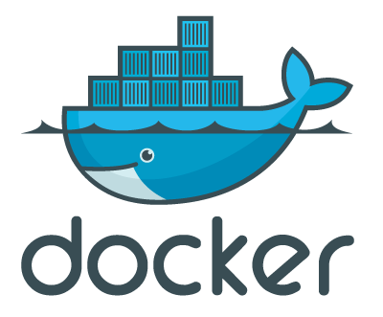
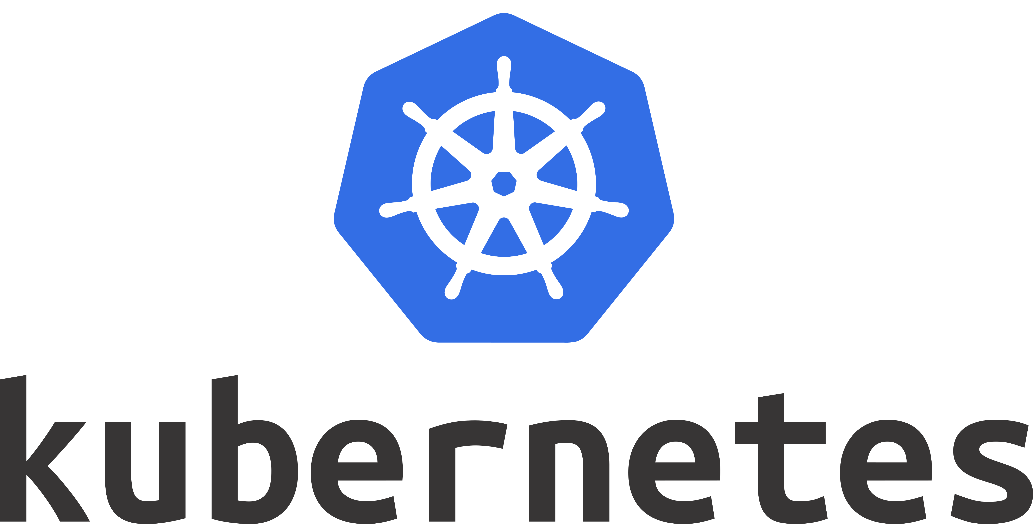
Vlab stack overview
Intuitive and creative
Consistent and maintainable
Scalable and flexible
Secure and robust
Notes:
The SINTEF Energy virtual lab is built to be robust and secure with Microsoft Azure with its Norwegian datacenters as the hosting provider. It is highly scalable and flexible with dynamic deployments and management of hardware and software through the use of Kubernetes, which means the experience will be the same regardless of hte amount of users. Kubernetes goes hand in hand with Docker, the preferred way of serving applications and keeping them up to date, Jupyter Notebooks and jupyterlab has become the “de facto” platform used by data scientists and users of models in general, and in this stack we are utilzing it to its full potential.

Slide 7
Vlab stack overview
Notes:
The SINTEF Energy virtual lab is built to be robust and secure with Microsoft Azure with its Norwegian datacenters as the hosting provider. It is highly scalable and flexible with dynamic deployments and management of hardware and software through the use of Kubernetes, which means the experience will be the same regardless of hte amount of users. Kubernetes goes hand in hand with Docker, the preferred way of serving applications and keeping them up to date, Jupyter Notebooks and jupyterlab has become the “de facto” platform used by data scientists and users of models in general, and in this stack we are utilzing it to its full potential.

Slide 8
Demo
Notes:
So, without further adue, let’s have a look at it. After signing up and having your user approved, you can log in. You will now be greeted with a a la carte menu of different docker images to choose from. The advantage of this, is that we can provide different versions of SHOP for you to select from, with different environment configurations and different pre-installed packages depending on the needs. For instance, the latest stable version of SHOP will always be available from the top and will be part of our automated release process, but we can also provide an environment with beta versions of new releases, freezed versions, customer specific versions or perhaps something targeted specific for students. This is all customizable and can be access based depending on your organisation role.
After choosing the appropriate server, we click the start button, and the mageic of theinfrastructure described a few minutes ago happens. Each individual user gets assigned their own secure, private storage area in the Azure cloud, called a persistant volume, and a individual docker container is being created for each user, giving you your very own with your very own ready-to-go environment of SHOP, useful applications and packages, everything guaranteed to work without any configuration. What also happens, is that a folder named «shop_examples» automatically will be synced from our public github repository, containing the latest runnable examples for shop. This gives you an immediadte chance to run SHOP without even writing as much as a single command.
But, since we are viewing live code i
Note that all of the examples that you can play with and run interactively here in the vritual lab, also is available in the SHOP Portal as a part of the more static documentation. The difference between the two of them is that you in the viertual lab can edit the cells containing python code and run them again with an operational kernel live in brower, instantly returning you updated results depending on your input.
Let’s go ahead and check out some examples. This is the basic example describing how to build a SHOP model in pyshop. You can inspect your input data, run SHOP and see your optimized results. If you are still using ASCII files to communicate the SHOP core, there is an example for that as well. The lab can also be used to view and edit any text based file. One of the big advantages with Jupyter notebooks is the ability to use the latest and greates ways to inspect and plot your results, for instance in this example where we import price forecasts from an excel file and construct a multi price bid matrix, using Plotly to inspect the results in various ways such as line plots, bar plots and heat maps.
Visualizing your data is perhaps even more important when it comes to cuts and water values, which is something we also have an example for. Why don’t you try to illustrate your cuts in a 3D-plane?
Python, Jupyter and pyshop also makes it easy to be interactive, for instance when you want to illustrate your best profit curve for different hours of the day. And why not make use of our built in function for plotting your water course, and applying some interactive elements on it – to lillustrate the reservoir levels in time, by dragging a slider?
These examples are here as a way to inspire you when building your own models in SHOP. If you want to base your own work on a current example, you can simply copy it out of the examples folder and into your own home directory, andmodify it as necessasry.
You can also start fresh, of course, and modify your environment as you would like through terminal commands or by other lab extensions. The possiblilties are endless here, and we will make sure to provide as many neat features as we can moving on.

Slide 9
Consistency across platforms
SHOP Portal
Origin of data (version controlled)
SINTEF Energy Virtual Lab
Vlab can be used to with git directly to add/edit files
Notes:
Now, I would also briefkly like to mention that we have started to host certain parts of SHOP publicly, both to encourage collaboration, but also to improve the consistancy of files and data across platforms, and thereby also reducing the amount of maintance needed. On github, you can now find us at sintef-energy, where we among other things host the examples that are synced to the virtual lab. The same notebook files are, without any duplication or manual process whatsover, used as rendered html versions on the SHOP Portal through the use of a neat tool named nbviewer. This means that if we edit or add any new examples in this git repository, either directly in the web interface or through any other development tool, the changes will be visisble immediately both on the virtual lab and on the portal automagically. We have also separated pyshop from the SHOP core, and it is now available on github as well, meaning you can contribute to it if you have specific suggestions. It is also publicly available as an official python package, which means that you can simply use this command to install it to whichever environment you like.
So to sum up, we strive to always improve how we communicate and collaborate with the users of our models, and we hope to find even more ways to do so in the future.
If you want to test out the new virtual lab, or read up on anything else regarding SHOP, there is one single point of origin you need to remember:
Shop.sintef.energy

Slide 10
shop.sintef.energy
Notes:
So, without further adue, let’s have a look at it. After signing up and having your user approved, you can log in. You will now be greeted with a a la carte menu of different docker images to choose from. The advantage of this, is that we can provide different versions of SHOP for you to select from, with different environment configurations and different pre-installed packages depending on the needs. For instance, the latest stable version of SHOP will always be available from the top and will be part of our automated release process, but we can also provide an environment with beta versions of new releases, freezed versions, customer specific versions or perhaps something targeted specific for students. This is all customizable and can be access based depending on your organisation role.
After choosing the appropriate server, we click the start button, and the mageic of theinfrastructure described a few minutes ago happens. Each individual user gets assigned their own secure, private storage area in the Azure cloud, called a persistant volume, and a individual docker container is being created for each user, giving you your very own with your very own ready-to-go environment of SHOP, useful applications and packages, everything guaranteed to work without any configuration. What also happens, is that a folder named «shop_examples» automatically will be synced from our public github repository, containing the latest runnable examples for shop. This gives you an immediadte chance to run SHOP without even writing as much as a single command.
Let’s go ahead and check out some examples. This is the basic example describing how to build a SHOP model in pyshop. You can inspect your input data, run SHOP and see your optimized results. If you are still using ASCII files to communicate the SHOP core, there is an example for that as well. The lab can also be used to view and edit any text based file. One of the big advantages with Jupyter notebooks is the ability to use the latest and greates ways to inspect and plot your results, for instance in this example where we import price forecasts from an excel file and construct a multi price bid matrix, using Plotly to inspect the results in various ways such as line plots, bar plots and heat maps.
Visualizing your data is perhaps even more important when it comes to cuts and water values, which is something we also have an example for. Why don’t you try to illustrate your cuts in a 3D-plane?
Python, Jupyter and pyshop also makes it easy to be interactive, for instance when you want to illustrate your best profit curve for different hours of the day. And why not make use of our built in function for plotting your water course, and applying some interactive elements on it – to lillustrate the reservoir levels in time, by dragging a slider?
These examples are here as a way to inspire you when building your own models in SHOP. If you want to base your own work on a current example, you can simply copy it out of the examples folder and into your own home directory, andmodify it as necessasry.
You can also start fresh, of course, and modify your environment as you would like through terminal commands or by other lab extensions. The possiblilties are endless here, and we will make sure to provide as many neat features as we can moving on.

