Slide 1
LTM-EOPS version 10

Slide 2
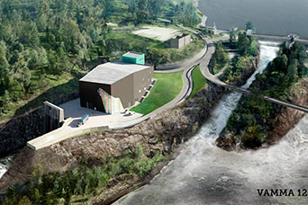
New Vamma 12 (2019): Calculate green certificate contribution
Increased power and capacity:
+ 128 MW
+ 500 m³/s
Upgraded Vamma station (total):
344 MW
1480 m³/s
Expected increase of 230 GWh/year

Slide 3
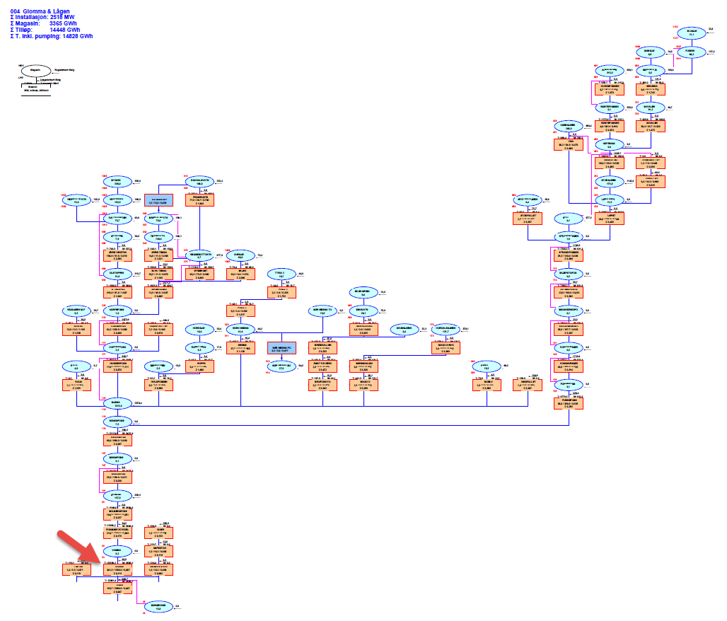

Slide 4
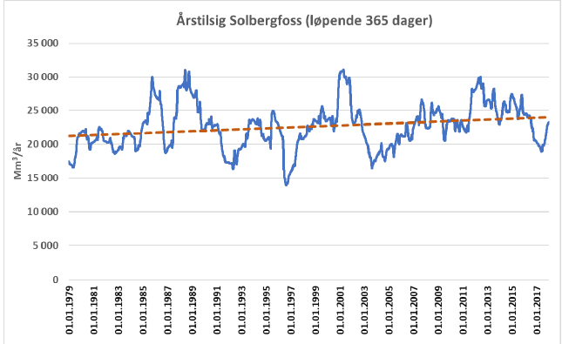
Yearly inflow trend curve
Yearly inflow Solbergfoss (365-day average)
Mm³/year

Slide 5
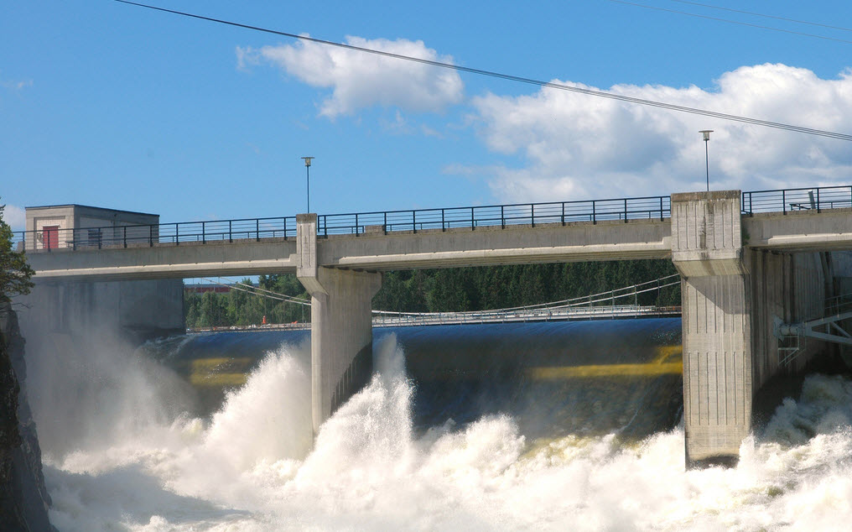
EOPS version 9:
Simulated average production increase in Vamma:
Period: GWh
1981 – 2010 192
1991 – 2010 195
1998 – 2017 234 (our proposal)
2008 – 2017 246
Problem: NVE *) only accepted 1981 - 2010 as simulation period
*) The Norwegian Energy Regulatory Authority

Slide 6
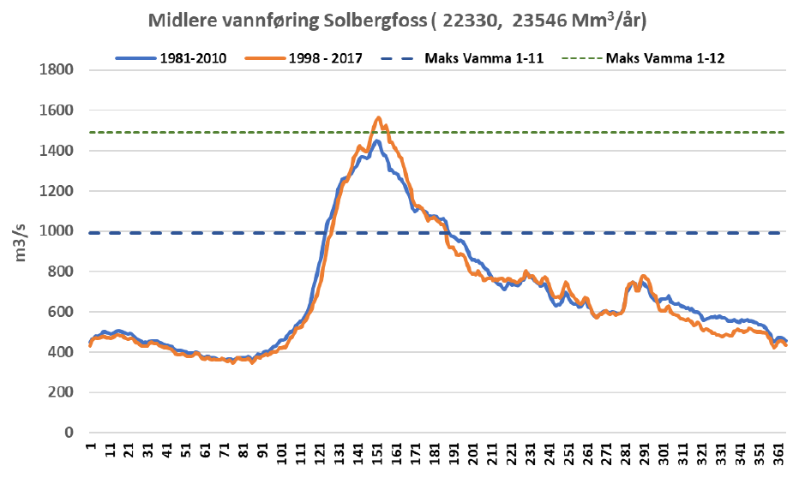
What about LTM-EOPS version 10 and daily inflow values?
Max. Vamma 1 - 11
Max. Vamma 1 - 12
Improved flow description gives more value of increased capacity

Slide 7
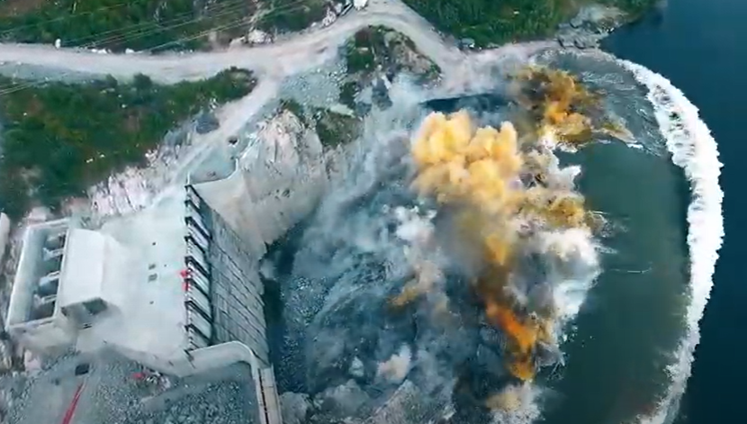
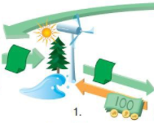
Simulated increase with EOPS version 10: 1981 – 2010 239 GWh
NVE accepted the use of EOPS version 10 and 239 GWh were added to our list of green certificates!

Slide 8
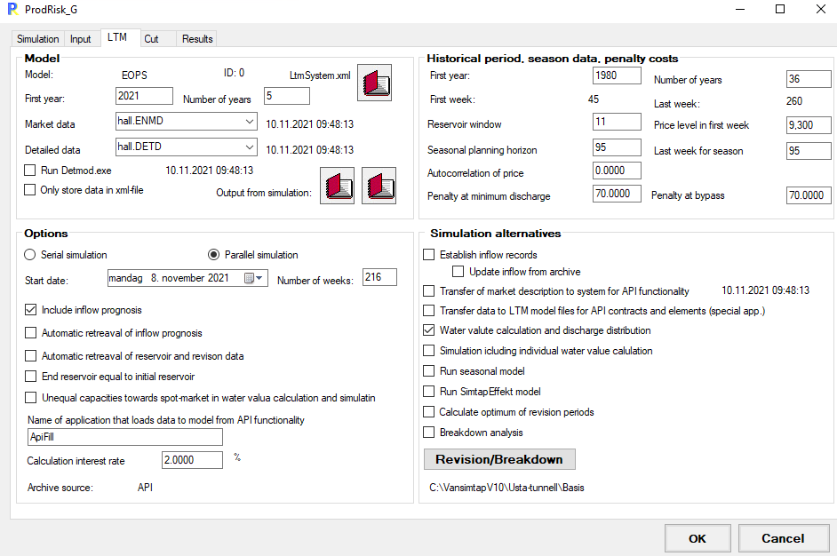
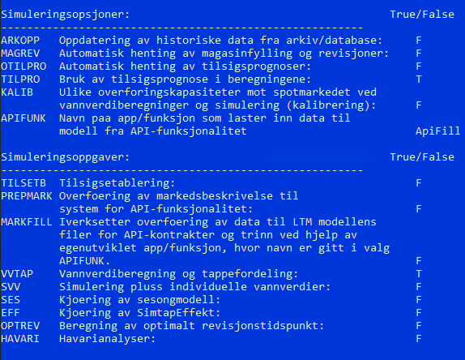
Other usage of EOPS v. 10: Revision and breakdown analysis Data initiation for ProdRisk New LtmSystem.xml file makes it easier to skip DOS.

Slide 9
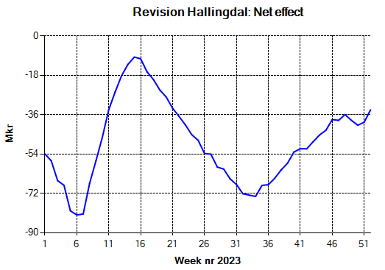
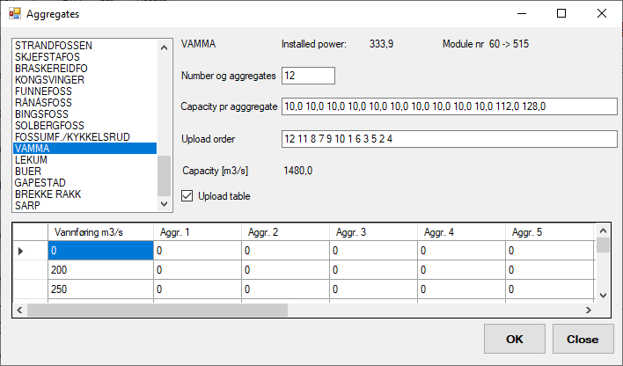
Examples:
Breakdown analyses:
Post-simulation calculation per aggregate
Data from file: revisjon.res
Split station production according to pre-defined upload table
EOPS: Find optimum period for revision.
ProdRisk: Run scenarios at given period with and without revision
for better accuracy.

Slide 10
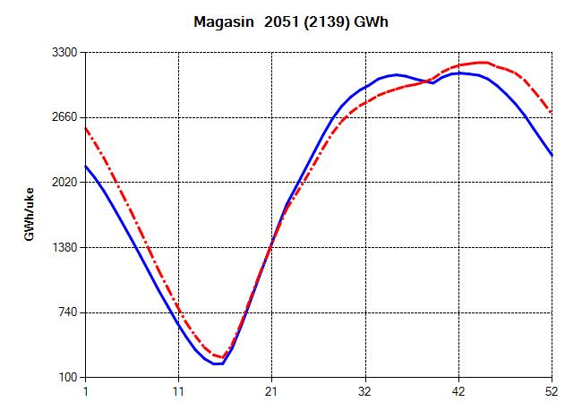
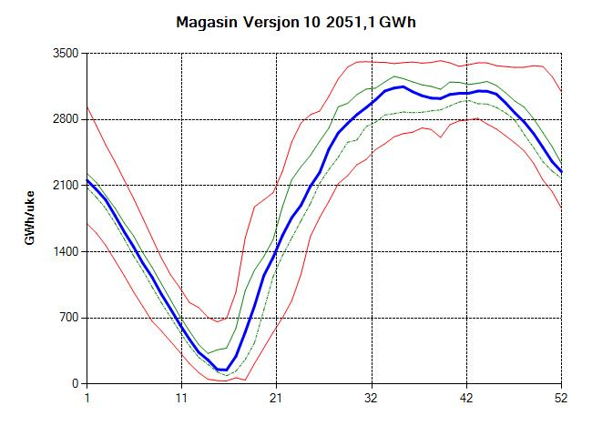
Other available improvement: Part of flow is included in water-value calculation Better reservoir damping at high levels
Average reservoir 9 vs 10
Reservoir version 10 (average 1051 GWh)
GWh/week
GWh/week

Slide 11
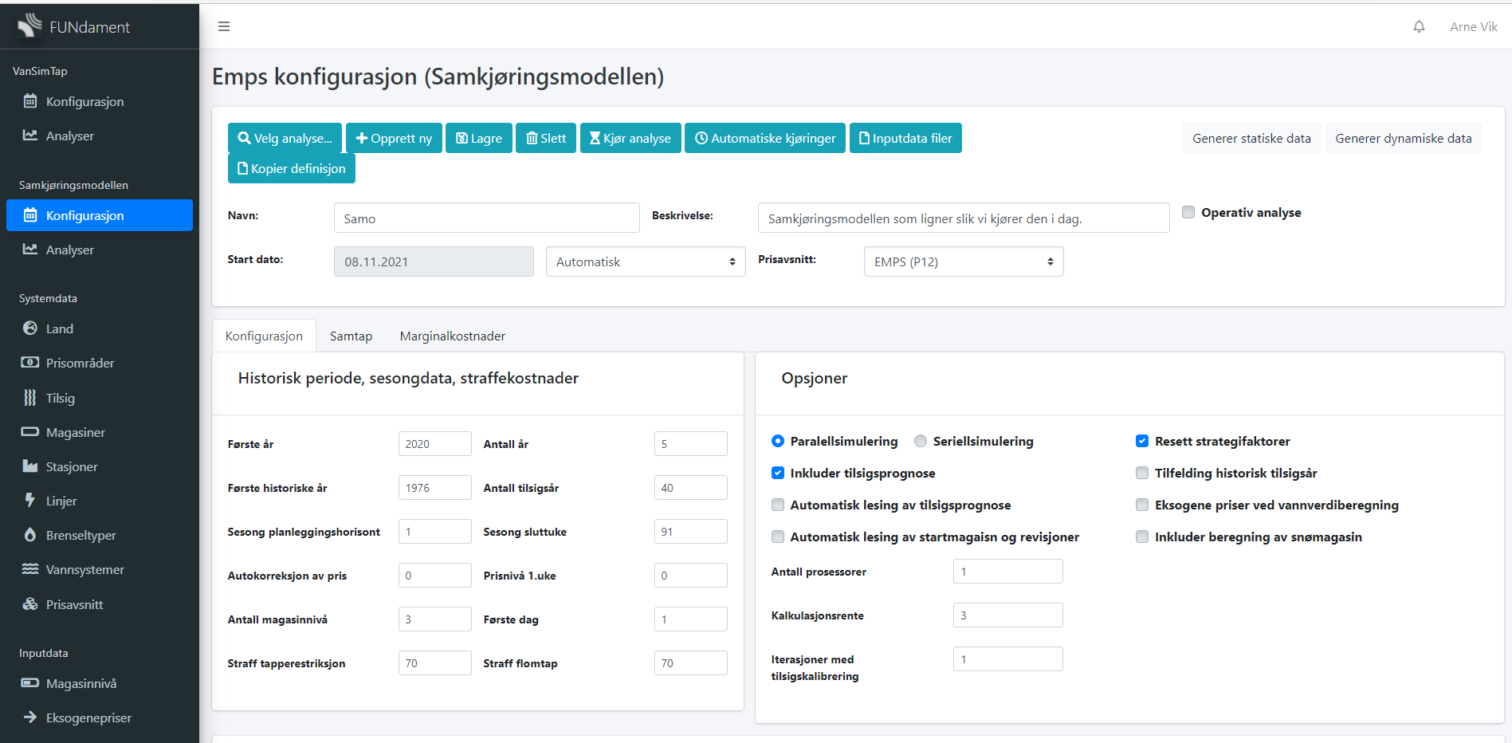
Working on cloud solution for EMPS / ProdRisk / EOPS + Thema

Slide 12
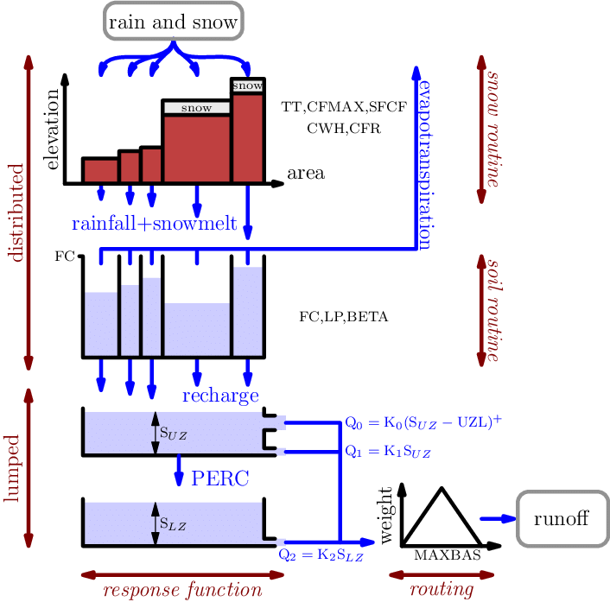
Cloud solutions give new possibilities and a lot of new challenges:
NordPool
Montel
NVE
ENTSO-E
Blob Storage
FDM
EMPS
Docker Container
- - - - -
EOPS
Thema
C# Python SQL
ProdRisk
XML, Javascript
Razor, Blazor
HDF5 format
SMG
Web Server / Client
HBV-model
Fire walls
API, Services

